Slide 1

Introduction to AVR Chapter 1
The AVR microcontroller
and embedded
systems
using assembly and c

Slide 2
Topics
Microcontrollers vs. Microprocessors
Most common microcontrollers
AVR Features
AVR members

Slide 3
General Purpose Microprocessors vs. Microcontrollers
General Purpose Microprocessors
General
Purpose
Micro
processor
Data BUS
RAM
ROM
Timer
Serial
COM
Port
IO
Port
Address BUS
Control BUS
Microcontrollers
CPU
RAM
ROM
Serial
Port
Timer
I/O

Slide 4
Most common microcontrollers
8-bit microcontrollers
AVR
PIC
HCS12
8051
32-bit microcontrollers
ARM
PIC32

Slide 5
AVR internal architecture

Slide 6
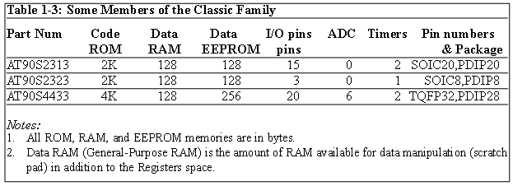
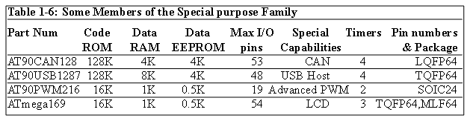
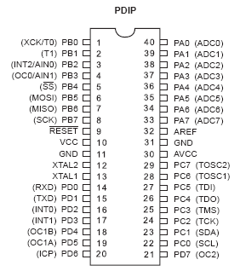
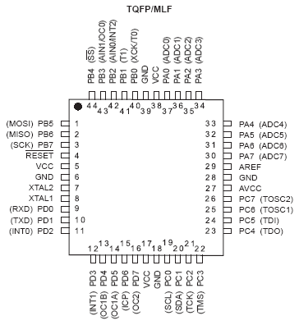
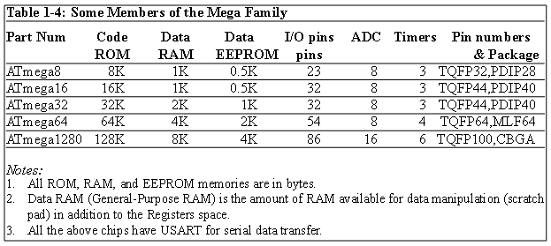
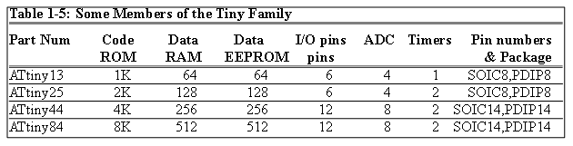
AVR different groups
Classic AVR
e.g. AT90S2313, AT90S4433
Mega
e.g. ATmega8, ATmega32, ATmega128
Tiny
e.g. ATtiny13, ATtiny25
Special Purpose AVR
e.g. AT90PWM216,AT90USB1287

Slide 7
Let’s get familiar with the AVR part numbers
ATmega128
Atmel
group
Flash =128K
ATtiny44
AT90S4433
Atmel
Tiny group
Flash =4K
Atmel
Classic group
Flash =4K

Slide 8
AVR Architecture (pp 55 - 75) Chapter 2
The AVR microcontroller
and embedded
systems
using assembly and c

Slide 9
Installing Programming tools for ATMEL devices.
Refer to AVRstudioTutorial.pdf in folder \Lecture Notes\E-Books and Reference for tutorial on how to write, compile, and trace a simple program ATmega32 in AVR Studio using Assembly language.
AvrStudio4Setup.exe which is the IDE that allow ATmega32 assembly program to be built, assembled, and simulated for execution, is in the folder \Lecture Notes\AVRStudio4\Installer
Install AvrStudio4Setup.exe first.
Then install AVRStudio4.18SP3.exe to Upgrade
Then Install WinAVR-20100110.exe which is in the folder \Lecture Notes\AVRStudio4\Installer\WinAVR-20100110.
Refer Overview on the AVR Instructions and Directive.pdf in \Lecture Notes\E-Books and Reference folder
Refer page 696 thru 732 of Microcontroller and Embedded Systems E-book in folder \Lecture Notes\E-Books and Reference for AVR Instruction Explained.

Slide 10
Topics
AVR’s CPU
Its architecture
Some simple programs
Data Memory access
Program memory
RISC architecture

Slide 11
AVR’s CPU
AVR’s CPU
ALU
32 General Purpose registers (R0 to R31)
PC register
Instruction decoder
CPU
ALU
R0
R1
R2
…
SREG:
H
N
Z
I
T
S
V
C
R15
R16
R17
PC
…
Instruction decoder
R30
R31
Instruction Register
registers

Slide 12
Some simple instructions 1. Loading values into the general purpose registers
LDI (Load Immediate)
LDI Rd, k
Its equivalent in high level languages:
Rd = k
Example:
LDI R16,53
R16 = 53
LDI R19,132
LDI R23,0x27
R23 = 0x27
CPU
ALU
R0
R1
R2
…
SREG:
H
N
Z
I
T
S
V
C
R15
R16
R17
PC
…
Instruction decoder
R30
R31
Instruction Register
registers

Slide 13
Some simple instructions 2. Arithmetic calculation
There are some instructions for doing Arithmetic and logic operations; such as:
ADD, SUB, MUL, AND, etc.
ADD Rd,Rs
Rd = Rd + Rs
Example:
ADD R25, R9
R25 = R25 + R9
ADD R17,R30
R17 = R17 + R30
CPU
ALU
R0
R1
R2
…
SREG:
H
N
Z
I
T
S
V
C
R15
R16
R17
PC
…
Instruction decoder
R30
R31
Instruction Register
registers

Slide 14
A simple program
Write a program that calculates 19 + 95
LDI R16, 19 ;R16 = 19
LDI R20, 95 ;R20 = 95
ADD R16, R20 ;R16 = R16 + R20
CPU
ALU
R0
R1
R2
…
SREG:
H
N
Z
I
T
S
V
C
R15
R16
R17
PC
…
Instruction decoder
R30
R31
Instruction Register
registers

Slide 15
A simple program
Write a program that calculates 19 + 95 + 5
LDI R16, 19 ;R16 = 19
LDI R20, 95 ;R20 = 95
LDI R21, 5 ;R21 = 5
ADD R16, R20 ;R16 = R16 + R20
ADD R16, R21 ;R16 = R16 + R21
LDI R16, 19 ;R16 = 19
LDI R20, 95 ;R20 = 95
ADD R16, R20 ;R16 = R16 + R20
LDI R20, 5 ;R20 = 5
ADD R16, R20 ;R16 = R16 + R20

Slide 16
Some simple instructions 2. Arithmetic calculation
SUB Rd,Rs
Rd = Rd - Rs
Example:
SUB R25, R9
R25 = R25 - R9
SUB R17,R30
R17 = R17 - R30
CPU
ALU
R0
R1
R2
…
SREG:
H
N
Z
I
T
S
V
C
R15
R16
R17
PC
…
Instruction decoder
R30
R31
Instruction Register
registers

Slide 17
R0 thru R15
Only registers in the range R16 to R31 can be loaded immediate. We cannot load a constant into the registers R0 to R15 directly. It would have to be loaded into a valid register first then copied. To load the value of 10 into register zero (R0): Code:
LDI R16,10 ;Set R16 to value of 10 MOV R0,A ;Copy contents of R16 to R0

Slide 18
Some simple instructions 2. Arithmetic calculation
INC Rd
Rd = Rd + 1
Example:
INC R25
R25 = R25 + 1
DEC Rd
Rd = Rd - 1
Example:
DEC R23
R23 = R23 - 1
CPU
ALU
R0
R1
R2
…
SREG:
H
N
Z
I
T
S
V
C
R15
R16
R17
PC
…
Instruction decoder
R30
R31
Instruction Register
registers

Slide 19
Data Address Space
Example: Add contents of location 0x90 to contents of location 0x95 and store the result in location 0x313.
Example: Store 0x53 into the SPH register. The address of SPH is 0x5E
Example: What does the following instruction do?
LDS R20,2
LDS (Load direct from data space)
STS (Store direct to data space)
Example: Write a program that stores 55 into location 0x80 of RAM.
Example: Write a program that copies the contents of location 0x80 of RAM into location 0x81.
Solution:
LDS R20, 0x90 ;R20 = [0x90]
LDS R21, 0x95 ;R21 = [0x95]
ADD R20, R21 ;R20 = R20 + R21
STS 0x313, R20 ;[0x313] = R20
LDS Rd, addr ;Rd = [addr]
STS addr,Rd ;[addr]=Rd
Solution:
LDI R20, 0x53 ;R20 = 0x53
STS 0x5E, R20 ;SPH = R20
Solution:
LDI R20, 55 ;R20 = 55
STS 0x80, R20 ;[0x80] = R20 = 55
Answer:
It copies the contents of R2 into R20; as 2 is the address of R2.
Example:
LDS R1, 0x60
Example:
STS 0x60,R15 ; [0x60] = R15
Solution:
LDS R20, 0x80 ;R20 = [0x80]
STS 0x81, R20 ;[0x81] = R20 = [0x80]

Slide 20
Data Address Space
Example: Write a program that adds the contents of the PINC IO register to the contents of PIND and stores the result in location 0x90 of the SRAM
OUT (OUT to IO location)
IN (IN from IO location)
Solution:
IN R20,PINC ;R20 = PINC
IN R21,PIND ;R21 = PIND
ADD R20,R21 ;R20 = R20 + R21
STS 0x90,R20 ;[0x90] = R20
OUT IOAddr,Rd ;[addr]=Rd
IN Rd,IOaddress ;Rd = [addr]
Using Names of IO registers
Example:
OUT SPH,R12 ;OUT 0x3E,R12
IN R15,SREG ;IN R15,0x3F
Example:
OUT 0x3F,R12 ;SREG = R12
OUT 0x3E,R15 ;SPH = R15
Example:
IN R1, 0x3F ;R1 = SREG
IN R17,0x3E ;R17 = SPH

Slide 21
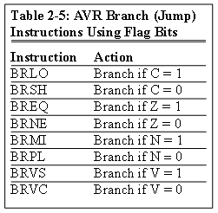
Status Register (SREG)
SREG:
I
T
H
S
V
N
Z
C
Interrupt
Carry
oVerflow
Zero
Temporary
Sign
N+V
Negative
Half carry
Example: Show the status of the C, H, and Z flags after the subtraction of 0x9C from 0x9C in the following instructions:
LDI R20, 0x9C
LDI R21, 0x9C
SUB R20, R21 ;subtract R21 from R20
Example: Show the status of the C, H, and Z flags after the subtraction of 0x23 from 0xA5 in the following instructions:
LDI R20, 0xA5
LDI R21, 0x23
SUB R20, R21 ;subtract R21 from R20
Example: Show the status of the C, H, and Z flags after the subtraction of 0x73 from 0x52 in the following instructions:
LDI R20, 0x52
LDI R21, 0x73
SUB R20, R21 ;subtract R21 from R20
Example: Show the status of the C, H, and Z flags after the addition of 0x9C and 0x64 in the following instructions:
LDI R20, 0x9C
LDI R21, 0x64
ADD R20, R21 ;add R21 to R20
Example: Show the status of the C, H, and Z flags after the addition of 0x38 and 0x2F in the following instructions:
LDI R16, 0x38 ;R16 = 0x38
LDI R17, 0x2F ;R17 = 0x2F
ADD R16, R17 ;add R17 to R16
CPU
ALU
R0
R1
R2
…
SREG:
Solution:
$52 0101 0010
- $73 0111 0011
$DF 1101 1111 R20 = $DF
C = 1 because R21 is bigger than R20 and there is a borrow from D8 bit.
Z = 0 because the R20 has a value other than zero after the subtraction.
H = 1 because there is a borrow from D4 to D3.
I
T
H
S
V
N
Z
C
Solution:
$9C 1001 1100
- $9C 1001 1100
$00 0000 0000 R20 = $00
C = 0 because R21 is not bigger than R20 and there is no borrow from D8 bit.
Z = 1 because the R20 is zero after the subtraction.
H = 0 because there is no borrow from D4 to D3.
Solution:
$A5 1010 0101
- $23 0010 0011
$82 1000 0010 R20 = $82
C = 0 because R21 is not bigger than R20 and there is no borrow from D8 bit.
Z = 0 because the R20 has a value other than 0 after the subtraction.
H = 0 because there is no borrow from D4 to D3.
Solution: 1
$9C 1001 1100
+ $64 0110 0100
$100 1 0000 0000 R20 = 00
C = 1 because there is a carry beyond the D7 bit.
H = 1 because there is a carry from the D3 to the D4 bit.
Z = 1 because the R20 (the result) has a value 0 in it after the addition.
Solution: 1
$38 0011 1000
+ $2F 0010 1111
$67 0110 0111 R16 = 0x67
C = 0 because there is no carry beyond the D7 bit.
H = 1 because there is a carry from the D3 to the D4 bit.
Z = 0 because the R16 (the result) has a value other than 0 after the addition.
R15
R16
R17
PC
…
Instruction decoder
R30
R31
Instruction Register
registers

Slide 22
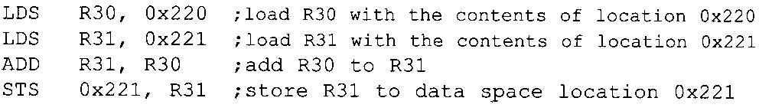
Writing Immediate Value to SRAM
You cannot copy immediate value directly into SRAM location in AVR.
This must be done via GPRs
Example: The following program adds content of location 0x220 to location 0x221

Slide 23
Exercise
Implement the program that calculates 19 + 95 + 5 on AVR Studio.
Use debug and watch the change of the respective registers as you step over through the program.
Watch Contents of R16 and check if answer is correct.

Slide 24
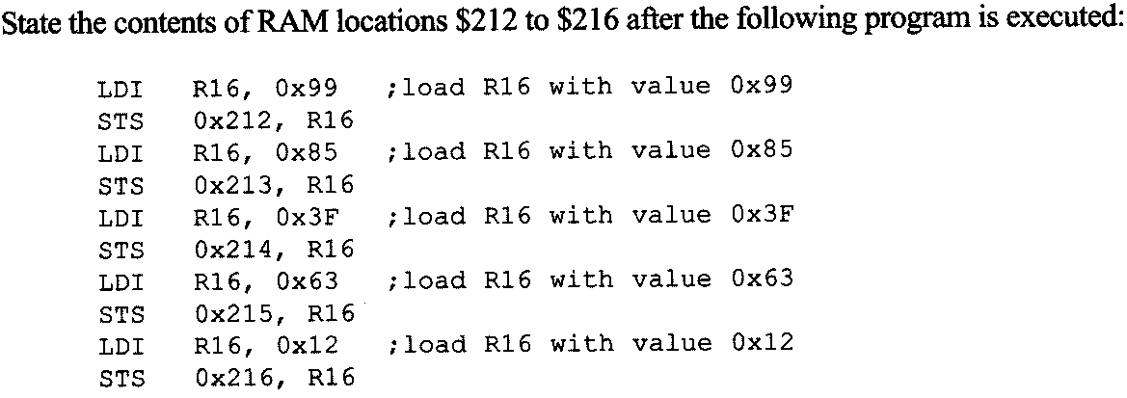
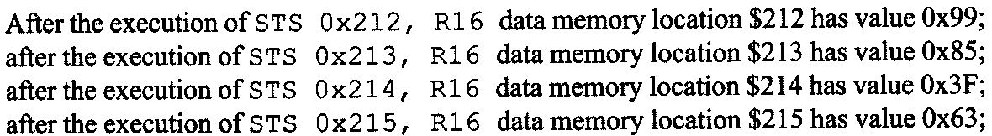
Example 2-1
Write the program in AVR Studio to verify that
Note: do not forget to add iat the beginning of the program:
.include "M32DEF.inc"

Slide 25
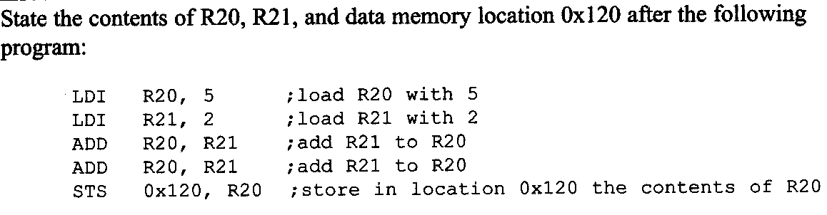
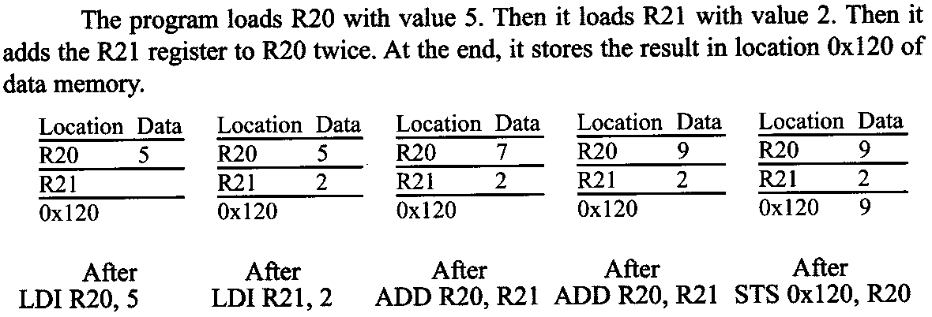
Example 2- 2
Verify using AVR Studio

Slide 26
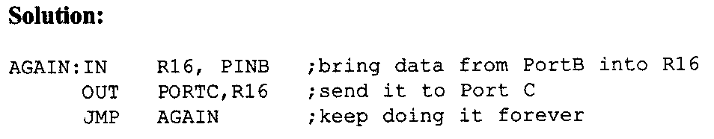
Example 2- 3

Slide 27
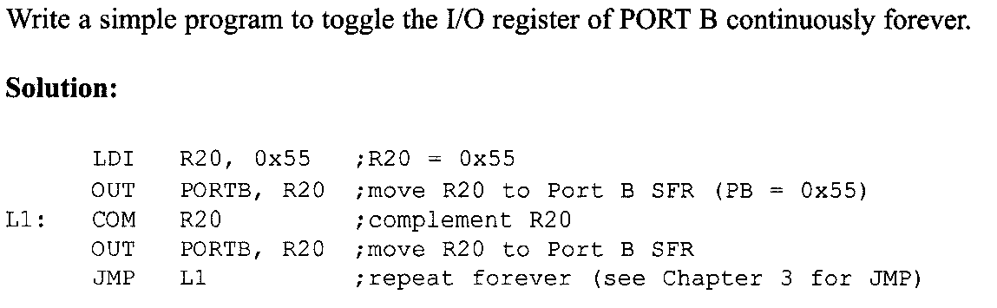
Example 2- 4

Slide 28
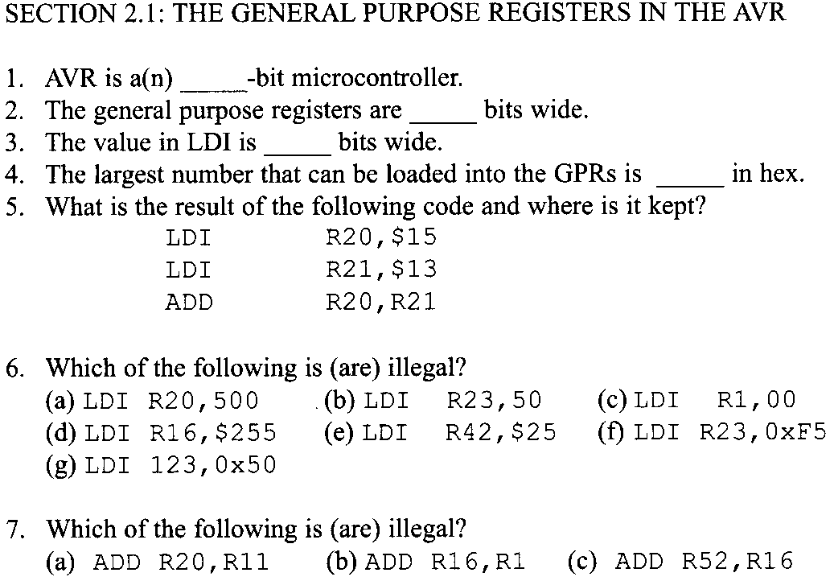
Problems (1)

Slide 29
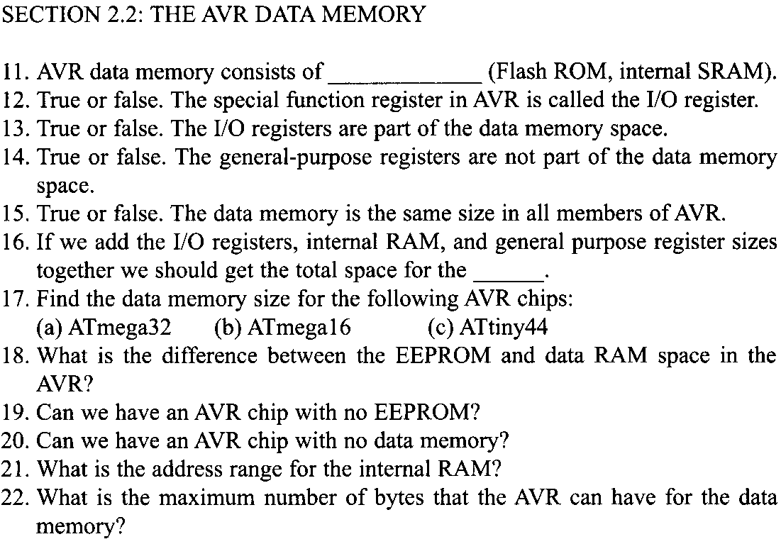
Problems (2)

Slide 30
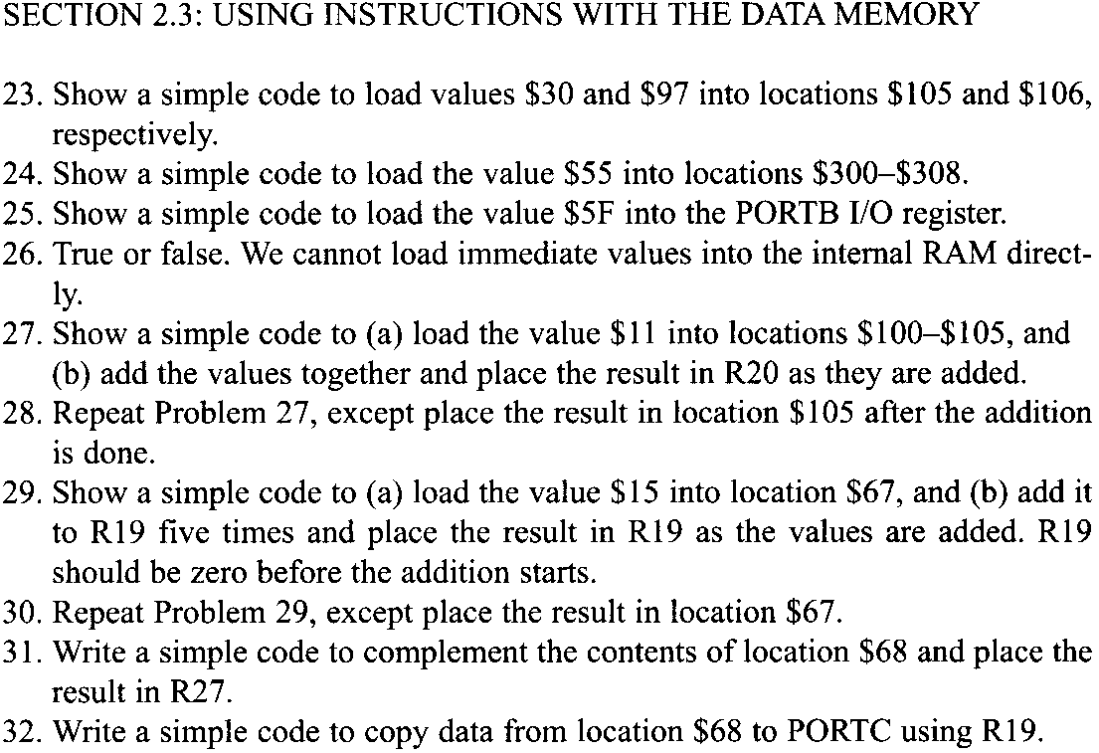
Problems (3)

Slide 31
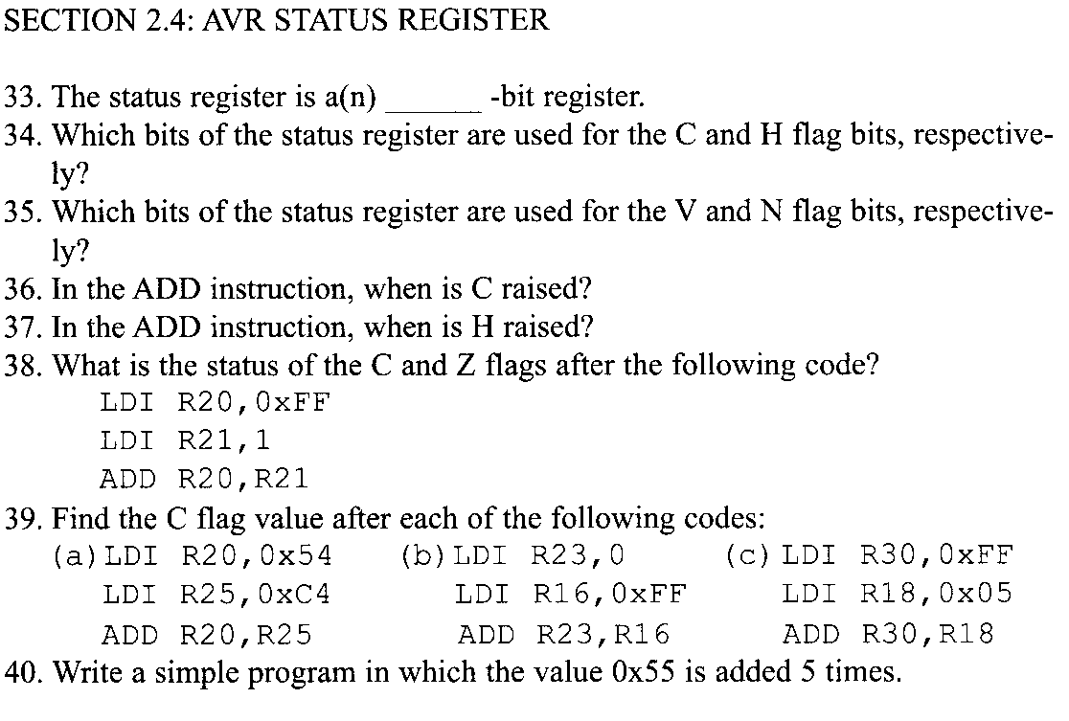
Problems (4)

